Slide 1
OAuth 2.0
Basic Understanding

Slide 2
What is OAuth ?

Slide 3
What is OAuth ?
Open Authentication and Open Authorization
OpenID by Twitter (2008), OAuth 1.0 (2010), OAuth 2.0 (2012)
Invented to solve Authenticate and Authorize problem
No need to create new account or submit Username and Password
Applications that allow user enter using Facebook, Google, etc. are using OAuth.
Notes:
note that:
openid require user to enter their username and password
oauth 1.0 has a cyber risk call Session Fixation

Slide 4
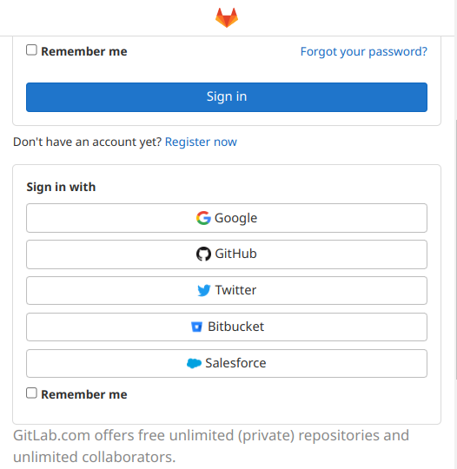
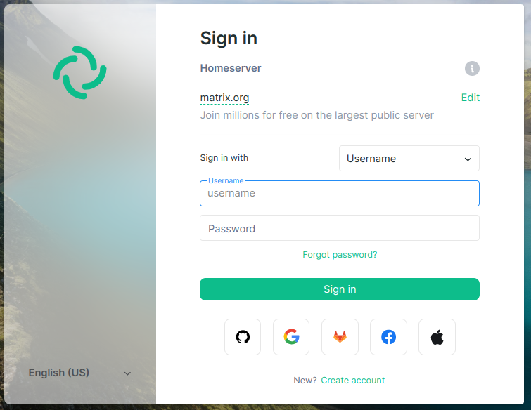
Some example of using OAuth

Slide 5
OAuth 2.0 Terminology

Slide 6
OAuth 2.0 Terminology
Resource Owner
Client
Authorization Server
Resource Server
Authorization grant
Redirect URI (Callback)
Access Token

Slide 7
How OAuth work ?

Slide 8
How OAuth Work ?
Application will request user for authorization to access to Resource server
If user agreed, application will be authorized from user in form of an authorization code
Application will send its own ID + authorization code to authorization server
If the user is authenticated and code is valid, the authorization server will return an access token
To access the data, the application must request to the resource server with an access token
If the token is valid and the query data is within the scope, resource server will return the requested data.

Slide 9
OAuth 2.0 Diagram

Slide 10
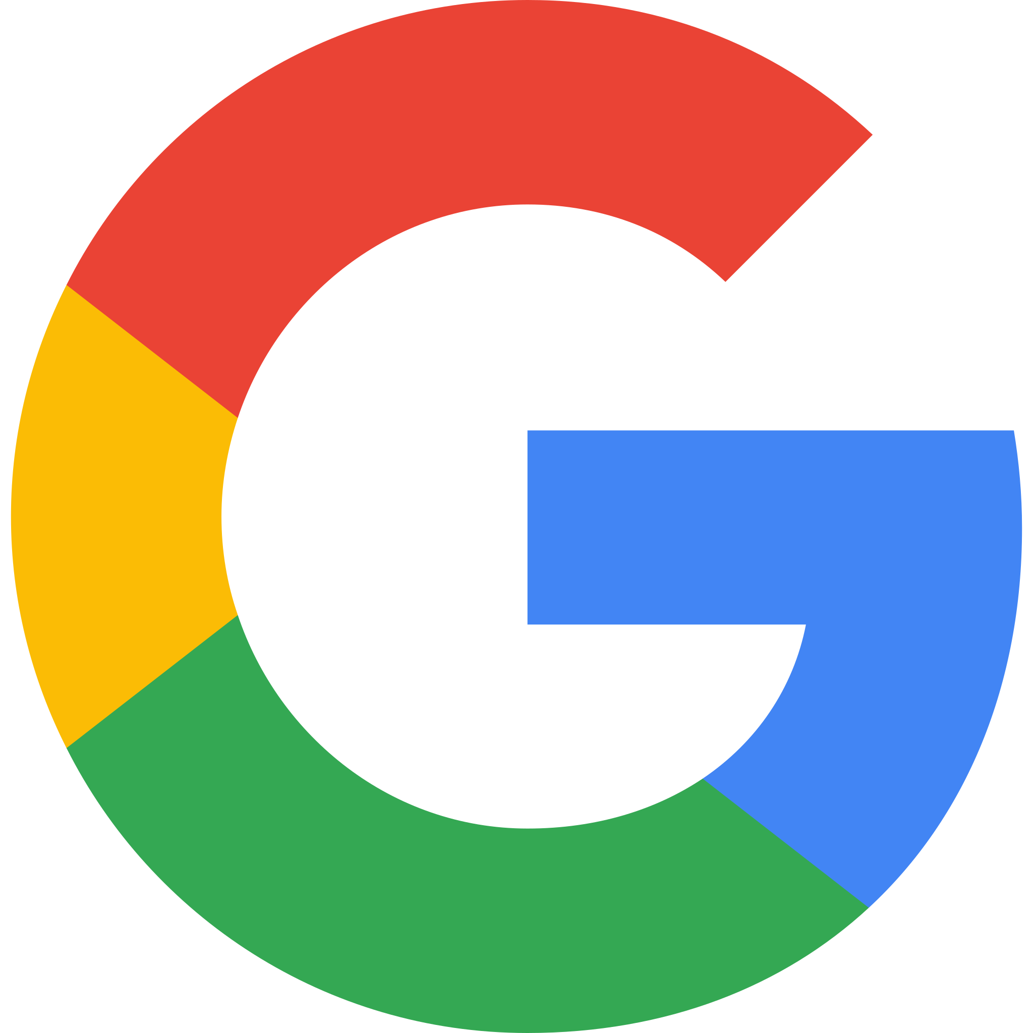
Simple OAuth 2.0 Diagram
Resource Owner
Authentication Server
2. User authentication on Google server
with callback url and scope
1. Login via Google
3 .Callback with an authorization code
Authorization Server
Application
4. Exchange authorization code into Access token
Resource Server
5. Request for data with access token

Slide 11
The end!
Thanks for your time!
Ref:
OAuth 2.0 and OpenID Connect (in plain English)
What is OAuth 2.0 ?

